Slide 1
KAPOOR JEWELLERS
Made By:
Nikhil Kapoor
Rajwinder Kaur

Slide 2
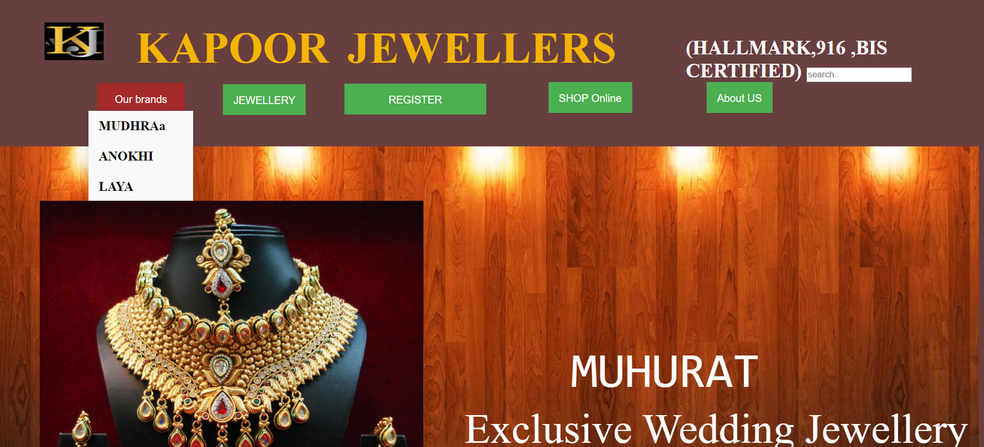
OUR BRANDS

Slide 3
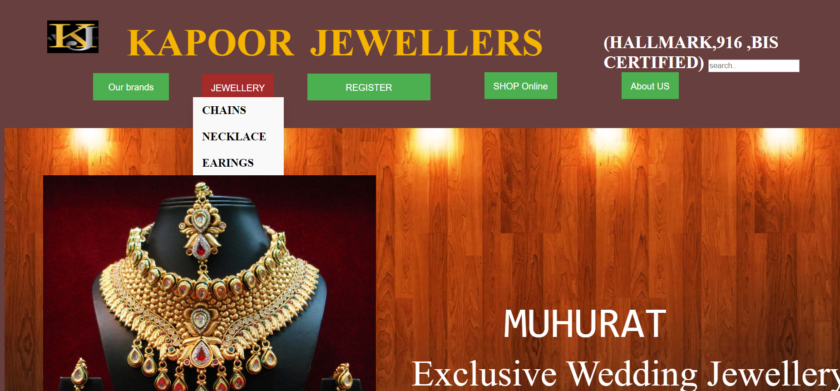
HOME

Slide 4
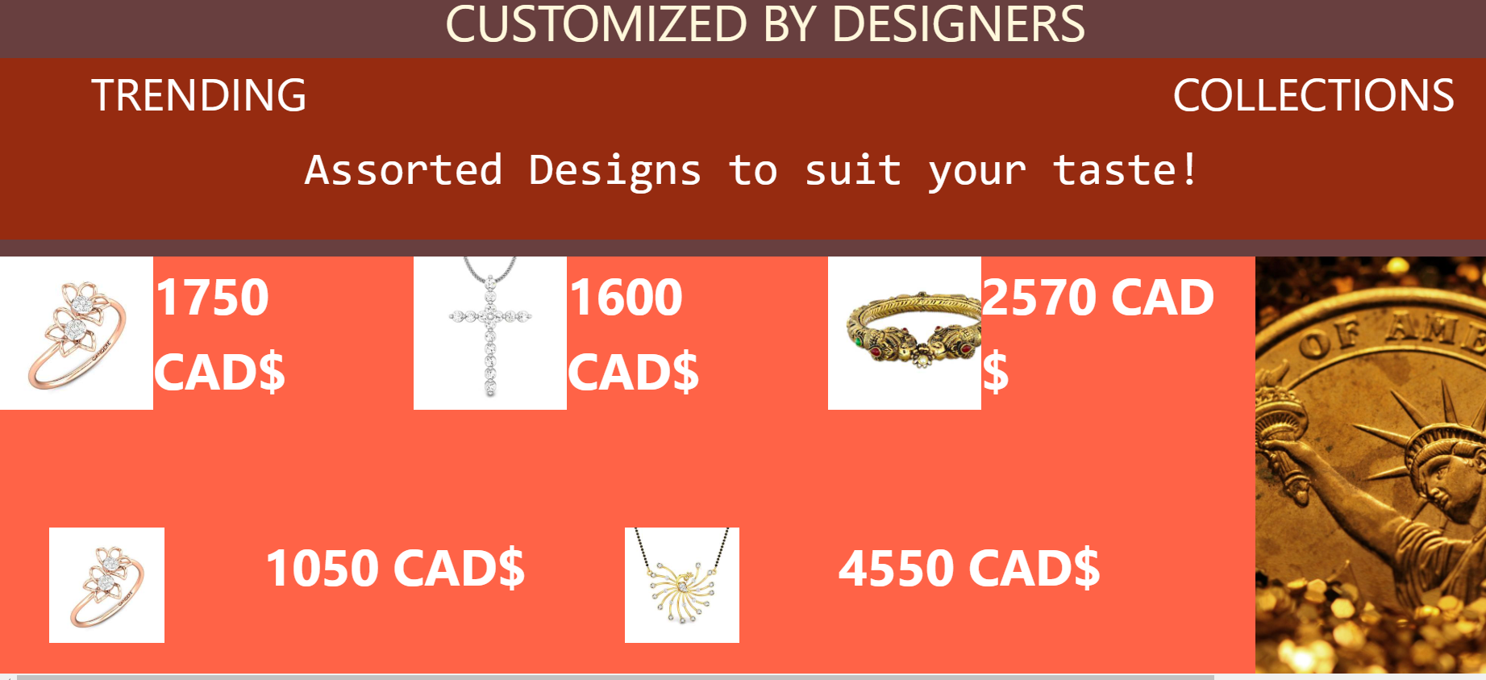
DESIGNS

Slide 5
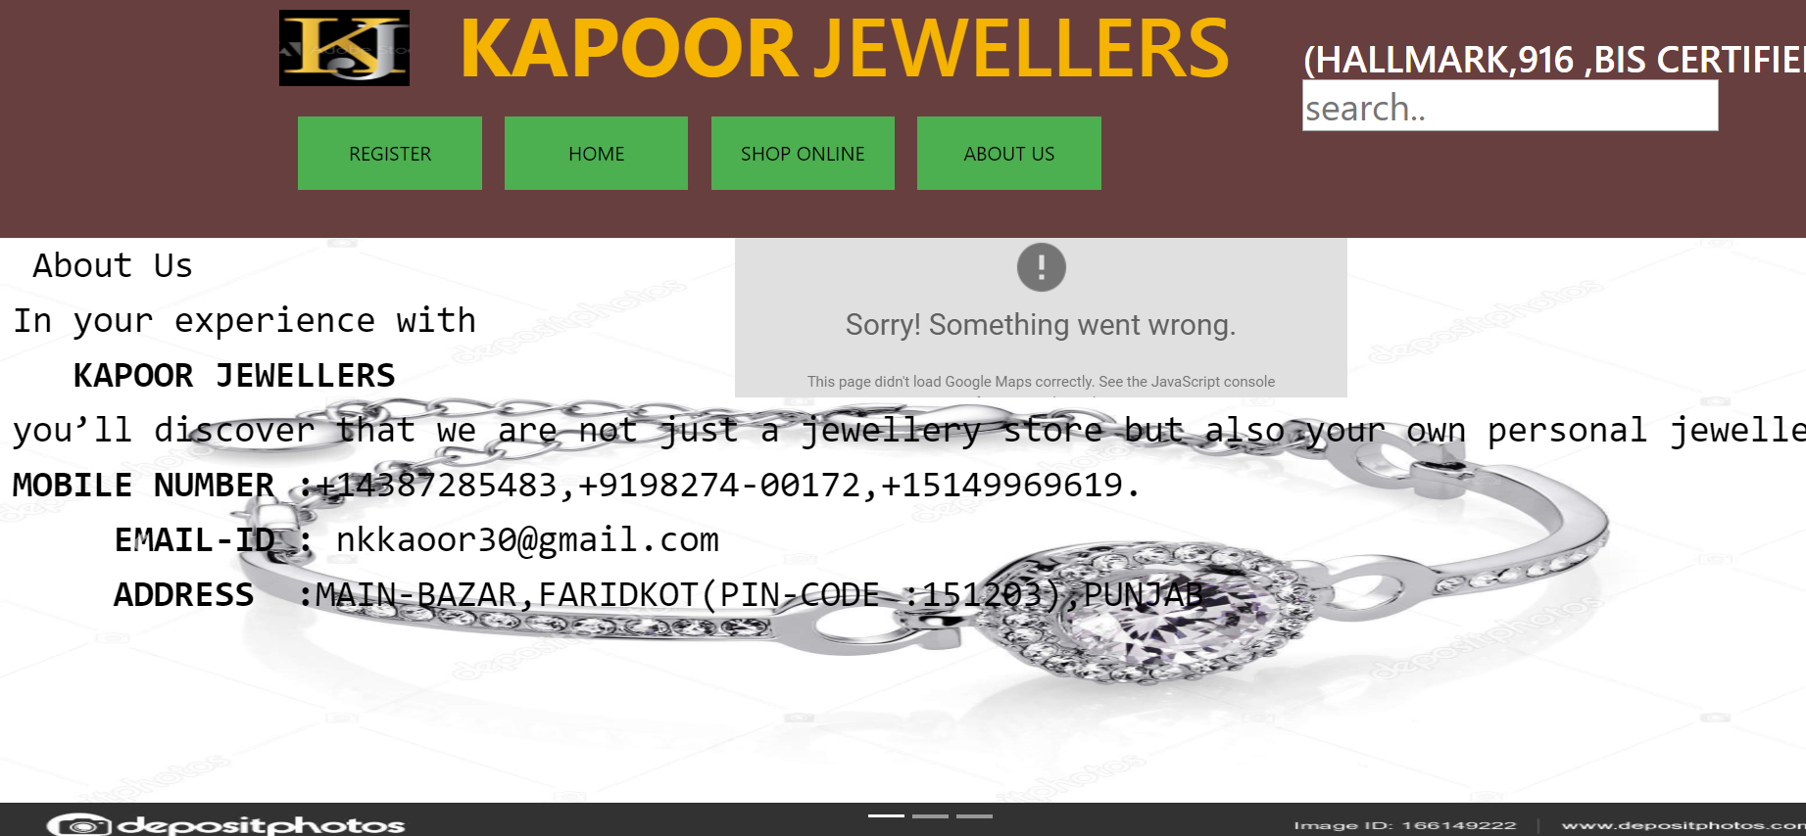
ABOUTUS

Slide 6
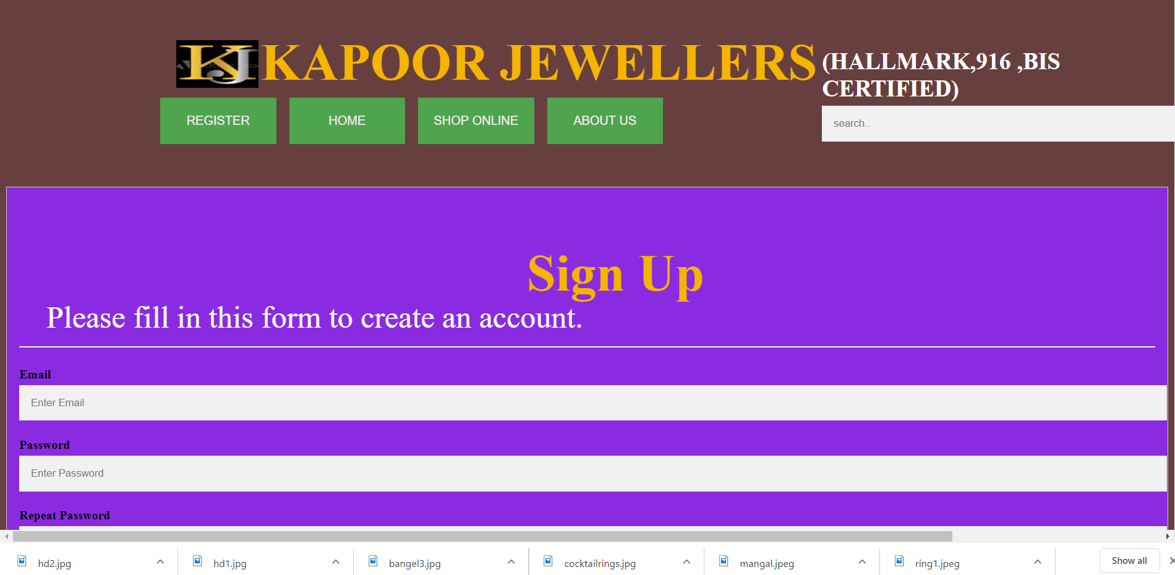
SIGN UP

Slide 7

SHOPPING ONLINE

